Slide 1
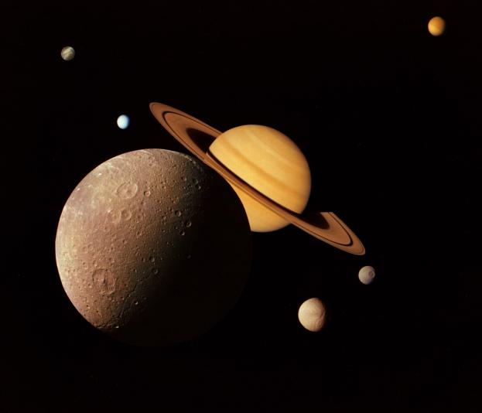
Saturn
The Moons of Saturn
The Planet Itself
Saturn’s Rings

